Slide 1

Global Health Week 2 Lecture Globalisation and health

Slide 2

Recap of some global health definitions
‘global health is an area for study, research, and practice that places a priority on improving health and achieving equity in health for all people worldwide. Global health emphasizes the transnational health issues, determinants, and solutions ; involves many disciplines beyond the health sciences and promotes interdisciplinary collaboration; and is a synthesis of population-based prevention with individual level clinical care’
Koplan et al (2009) Towards a common definition of global health. The Lancet, 373(9679) pp.1993-1995

Slide 3
Global health definitions
‘ a health issue where the determinants or outcomes are not contained by the territorial boundaries of states and thus may be beyond the capacity of individual countries to address them through domestic institutions alone’
Hanefield (2015)

Slide 4
Nobel Medicine Prize 2020
https://www.bbc.co.uk/news/health-54418463
Hep C research scientists – winners

Slide 5
LSE blogs
Cov 19 and globalisation
Manouche Shafik
https://blogs.lse.ac.uk/covid19/2020/04/28/you-cannot-solve-a-global-pandemic-with-national-policies/

Slide 6
Interesting online events /blog posts
https://www.fmg.ac.uk/events/shaping-post-covid-recovery-response-africa
Blog posts about Nepal
https://blogs.lse.ac.uk/covid19/2020/09/15/more-men-die-from-covid-19-in-nepal-but-who-suffers-most/
Women in Sub Saharan African countries and Cov 19
https://blogs.lse.ac.uk/covid19/2020/07/28/sub-saharan-countries-are-taking-on-more-debt-and-women-will-bear-the-brunt-of-repaying-it/
Successful Cov 19 vaccination campaigns ?
https://blogs.lse.ac.uk/covid19/2020/09/01/what-a-successful-covid-19-vaccination-campaign-would-look-like/

Slide 7
Current topical global health issues
WHO and covid responses
https://www.who.int/emergencies/diseases/novel-coronavirus-2019
Wild polio virus
https://www.who.int/news-room/feature-stories/detail/two-out-of-three-wild-poliovirus-strains-eradicated
Disruption of health services globally due to Cov 19
https://www.who.int/news-room/detail/31-08-2020-in-who-global-pulse-survey-90-of-countries-report-disruptions-to-essential-health-services-since-covid-19-pandemic

Slide 8
Globalisation
Think about where the clothes you are wearing were made?
What about your mobile phone/ laptop/ tablet device? Where were these made?
What about your shoes / bag?
We will discuss some of these ideas in the interactive seminar

Slide 9
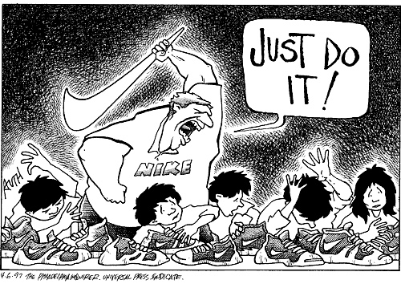
Globalisation
What is globalisation?
What do we mean by this term ?
Write down your own definition of this
What influence does globalisation have on health?
What health issues have a global impact?

Slide 10
What does globalisation mean to you?
In the last 10-20 years how has your life changed ?
What technologies have changed?
Do you communicate with people in a different way from 10 years ago?
Has the way you socialise changed?
Has the way you manage or monitor your health changed?
Write down some ideas on this .

Slide 11
Cultural changes with globalisation-What impact has it had on you?
In the last 15 years what cultural changes has globalisation brought?
Discuss how these have had a direct impact on your life
How have these changes had an impact on your health?
Discuss how these changes have had an impact on communities worldwide.
Notes:
Eg proliferation of call centres in India available 24/7 – changing family /social structures

Slide 12
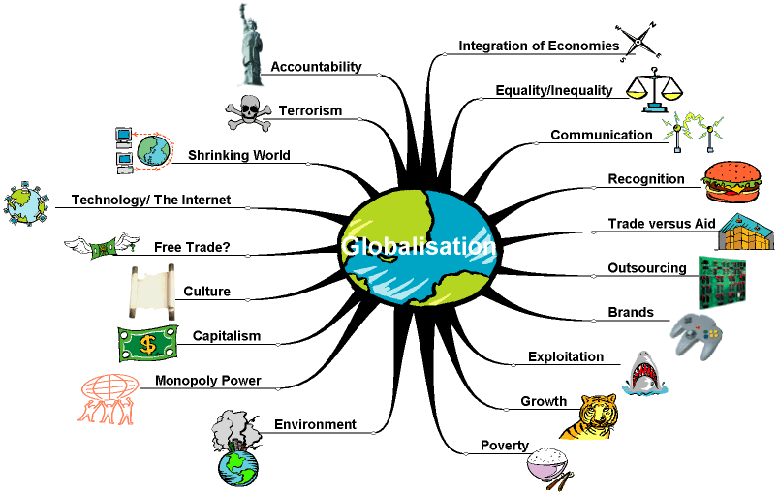
Globalisation

Slide 13
Globalisation and health
How does globalisation intersect with health?
Global Health interested in any health issues that concerns many countries or is affected by determinants that cross borders ; Cov 19 climate change, urbanization, eradication of polio; influenza , H1N1 (swine flu), Avian flu H5N1 – all of these have global influence
Non communicable conditions – common cancers can have different local patterns but affect huge number of people
Jacobsen (2014) McCracken and Phillips (2012)

Slide 14
Influence of globalisation on health
Some would argue that the cultural influences of globalisation and particularly western patterns of consumption have had a negative impact on health, the environment and society such as increases in; obesity, heart disease, environmental damage, global warming ,climate change and also altered family structures and decreasing health and welfare
McCracken and Phillips (2012) Jacobsen (2014)
Notes:
Changing patterns of work – altering family structures
Relocation of traditional industries to locations with cheaper costs

Slide 15
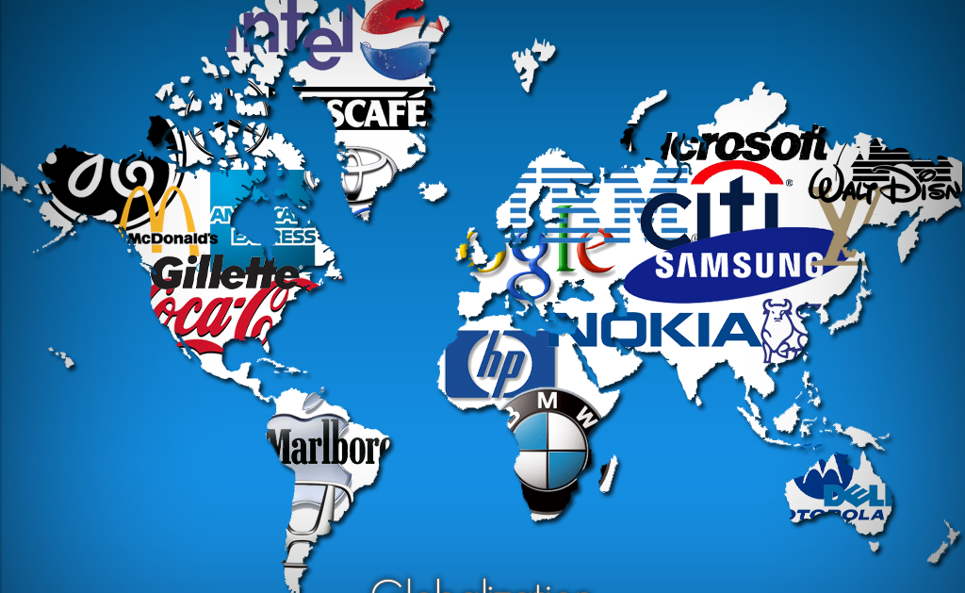
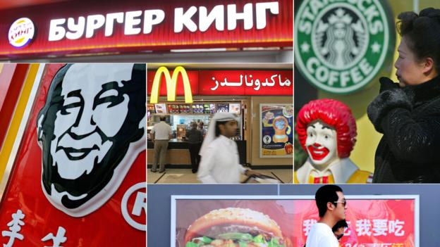
Effects of globalisation

Slide 16
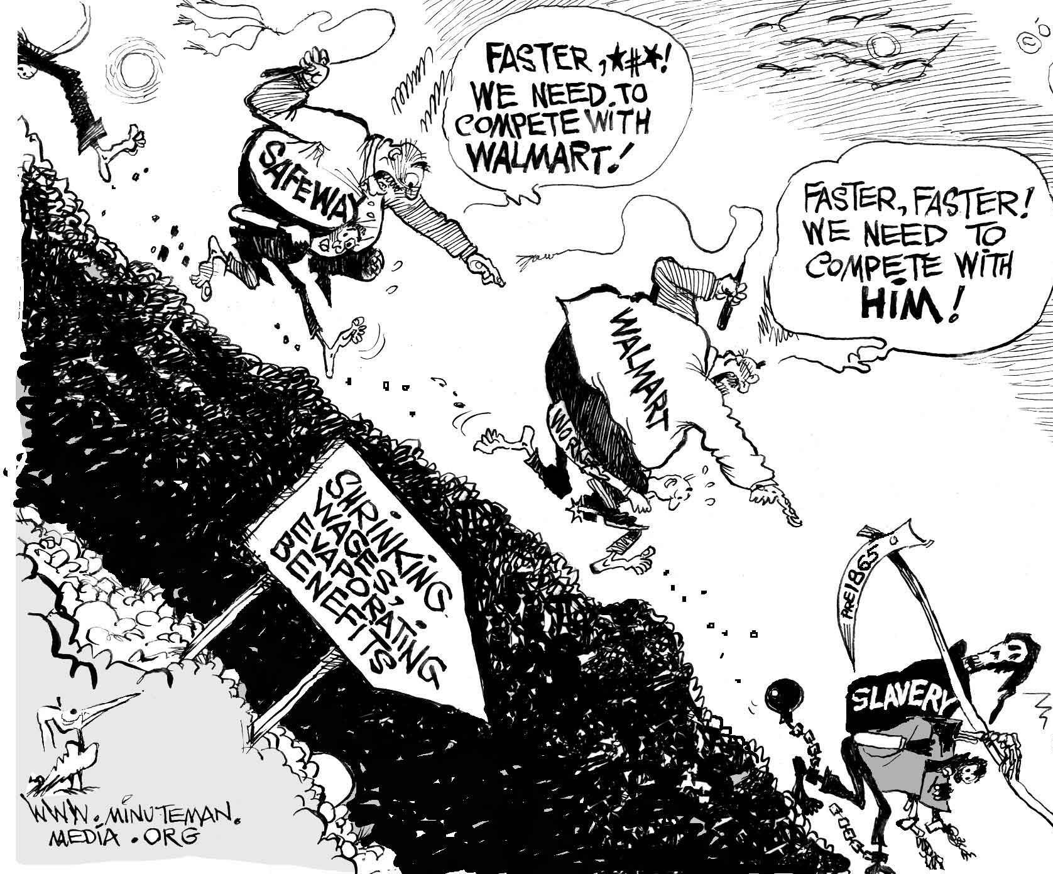
Globalisation effects

Slide 17
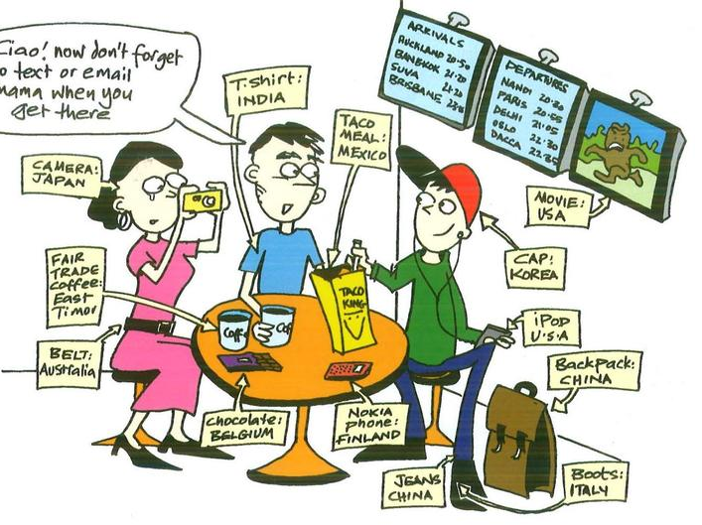
Effects of globalisation

Slide 18
Globalisation
Hanefield (2015) discusses globalisation in the context of 3 dimensions of global change
Spatial
Temporal
Cognitive

Slide 19

Globalisation- spatial change
Changes in how we perceive physical and territorial space
Increase in population mobility
More affordable travel
More long term migration
Movement of microbes – spread of infectious diseases
Hanefield (2015 pp.3-5)
Notes:
Globalisation leading to changes along spatial dimensions

Slide 20

Temporal change
Travel greater distances quickly through high speed air travel
Faster communications
Faster medical research
For some increased leisure time – for others increased insecurity in work in the post-industrial age
Hanefield (2015 pp. 3-5)
Notes:
Globalisation is changing our relationship with time
Increased bureaucratisation

Slide 21

Cognitive change
How globalisation is changing what we think about ourselves and the world around us
Mass media has become global eg -Many national media outlets in different countries belonging to large transnational companies, global advertising agencies and consultancy firms
Since the 1980s convergence of modes of communication – deregulation and privatisation of telecommunications sector
Hanefield (2015 pp. 3-5)
Notes:
Global media landscape shapes how people access and consume news – determines their impact on how we perceive the world
Until the 1980s most media was national
– much of the news consumed
Social media sites and the ability of people to connect across the globe
More immediate and greater exchanges of people living in different continents

Slide 22

Globalisation
Greater movement of people and pathogens , greater knowledge exchange across physical borders leading to scientific advances, increased solidarity around health issues
In addition to the challenges to our mental, physical health and wellbeing the social patterns of our lives have changed.

Slide 23

Information and transportation technology as key drivers of globalisation
Information technology has been critical to the kinds of changes associated with globalisation
Enormous leaps in technological development – exponential growth in use due to falling costs

Slide 24
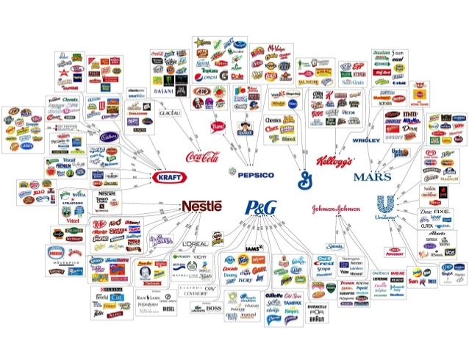
Globalisation
‘Increasing and accelerating processes of regional economies, societies and cultures integrating through rapid global communication and exchange networks’
Includes both economic and cultural transitions
Often associated with global westernisation of lifestyles and consumption habits (eg MacDonaldization, sports brands, music, TV, film)
McCracken and Phillips (2012)

Slide 25
Globalisation
The movement towards the expansion of economic and social ties between countries through the spread of corporate institutions and the capitalist philosophy that leads to the shrinking of the world in economic terms.
Definition:
The process by which businesses or other organizations develop international influence or start operating on an international scale.
OED, 2016
An economic, social and cultural phenomenon.

Slide 26

Globalisation
The largest companies are no longer national firms, located in one single country; they are multinational corporations with businesses in many countries.
Globalisation has been taking place for hundreds of years but has rapidly increased over the last 30 years or so.
Globalisation has resulted in:
increased international trade
the same company operating in more than one country
a greater dependence on the global economy
easier movement of capital, goods and services
recognition of companies such as McDonalds and Starbucks in developing countries

Slide 27
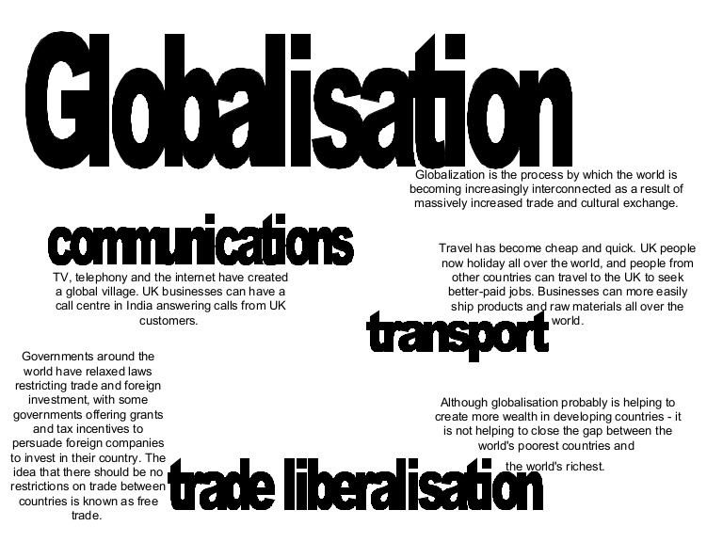
Globalisation
Increased competition between national economies which is facilitated through communication networks, transport, trade, foreign exchange, foreign direct investment, capital and labour movement, technology driven markets
An increased common understanding of popular culture, foods, language , media, TV, film, strong influence of particularly American TV
McCracken and Phillips (2012)

Slide 28

Globalisation
Increased interconnectedness of communities via mobiles, internet and telecommunications
A digital divide remains between developed and less developed nations but there is some increased development with many less developed nations skipping stages of development through digital communication. McCracken and Phillips (2012)

Slide 29
Globalisation
‘The increasing interconnectedness between societies such that events in one part of the world more and more have effects on peoples and societies far away’
Baylis et al (2008)
‘a stretching of social, political and economic activities across frontiers such that events, decisions and activities in one region of the world can come to have significance for individuals and communities in distant regions of the globe’
(Held et al 1999)

Slide 30
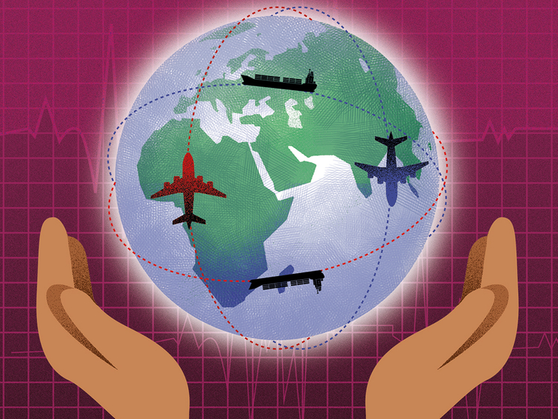
Globalisation - The theory…
The integration of economies
The increasing reliance of economies on each other
The opportunities to be able to buy and sell in any country in the world
The opportunities for labour and capital to locate anywhere in the world
The growth of global markets in finance.

Slide 31
Made possible by:
Technology
Communication networks
Internet access
Growth of economic cooperation – trading blocs (EU, NAFTA- North American Free Trade Agreement, etc.)
Movement to free trade – TRADE LIBERALISATION

Slide 32

The World Trade Organization
WTO Principles
https://www.wto.org/
Non discrimination between nations - any trade concessions offered to a nation must be offered to others.
Reciprocity - nations try to provide similar concessions for each other.
Transparency - negotiations and process must be fair and open with rules equal for all.
Special and differential treatment - recognition that developing countries may require “positive discrimination” because of historic unequal trade.

Slide 33
The World Trade Organization
The reality
Opaque and not allowing enough public participation, while being very welcoming to large corporations.
Importing nations cannot distinguish how something is made when trading:
Countries cannot say no to genetically engineered food
or milk that contains growth hormones
or trees that have been felled from pristine forests
Multinational corporations are favoured over Governments

Slide 34
The trade versus aid argument
Benefits of Trade:
Increased choice
Greater potential for growth
Increase international economies of scale
Greater employment opportunities

Slide 35
Trade versus Aid?
Disadvantages of trade:
Increase in gap between the rich and the poor
Dominance of global trade by the rich, northern hemisphere countries
Lack of opportunities for the poor to be able to have access to markets
Exploitation of workers and growers

Slide 36

Corporate Expansion
Multi-national or trans-national corporations (MNCs or TNCs) – businesses with their headquarters in one country but with business operations in a number of others.

Slide 37
What does this mean for health?
A. International transfer of health risks
Infectious diseases and international travel
Risks associated with transfer of lifestyles
Health and safety standards
B. Globalization of health care services
Movement of health providers (incl. “brain drain”)
Health tourism
Cross border establishment of facilities
C. International governance
The major players: World Trade Organisation, World Bank, International Monetary Fund, WHO

Slide 38
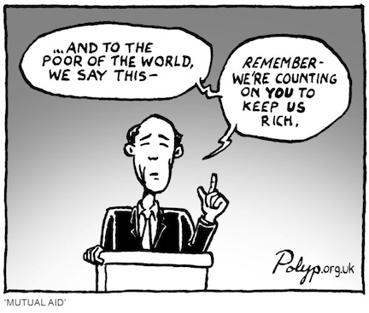
Neoliberalism is…
An ideology and policy model that emphasizes the value of free market competition… neoliberalism is often characterized in terms of its belief in sustained economic growth as the means to achieve human progress, its confidence in free markets as the most-efficient allocation of resources, its emphasis on minimal state intervention in economic and social affairs, and its commitment to the freedom of trade and capital.
Encyclopaedia Britannica (2016)

Slide 39
What do you think global health means?
These videos are also available on blackboard – please watch these prior to the session. They provide some useful background discussion on contemporary global public health issues
we will discuss some of the issues raised in these videos in the interactive session.
Globalisation and public health
https://www.youtube.com/watch?v=cBOe1YBQZwU
https://www.youtube.com/watch?v=WlMyHIaVxmA

Slide 40
UK Global Health Strategy 2014-2019 (PHE) Health is Global (Reports 2008/2011)
These reports discuss the range of health issues that are influenced by factors that transcend state borders
Such as the UK readiness for;
Pandemic influenza
Emerging infections
Climate change
International development – supporting development in developing countries
Health care industry
Pharmaceutical industry
Foreign policy – national and global security
Economic wealth
Trade
Human rights
Humanitarian assistance
McCracken and Phillips (2012)

Slide 41
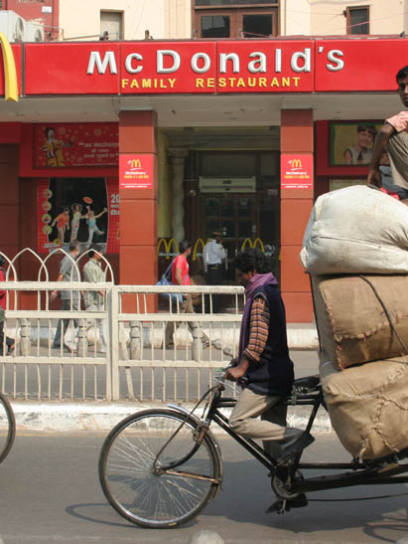
Influence of globalisation on health
Some would argue that the cultural influences of globalisation and particularly western patterns of consumption have had a negative impact on health, the environment and society such as increases in; obesity, heart disease, environmental damage, global warming ,climate change and also altered family structures and decreasing health and welfare
Changing patterns of work – altering family structures
Relocation of traditional industries to locations with cheaper costs
McCracken and Phillips (2012)

Slide 42
Lifestyle factors and influence on health
Alcohol
Tobacco
Drug consumption
Micronutrient deficiencies
Overweight/ Obesity
Injury prevention
Health of specific communities eg such as migrant groups

Slide 43
Videos on the effects of globalisation
These are also available on blackboard – please watch to develop your understanding further of some of the debates relating to globalisation
BBC hard talk about effects of globalisation in India
https://www.youtube.com/watch?v=QGLseQFTgeM
Joseph Stglitz critiquing globalisation
https://www.youtube.com/watch?v=sV7bRLtDr3E
Noam Chomsky critique on globalisation
https://www.youtube.com/watch?v=AHJPSLgHemM

Slide 44
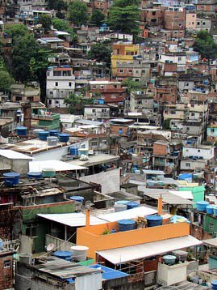
Local and global influences on health
People are primarily influenced by their local environment – their natural, social, urban, suburban or rural environment
However the natural environment is changing and has an effect on health (eg rapid urbanisation, climate change effects)
Socio –economic conditions are undergoing rapid transition - eg reduction in public services, healthcare provision and access to services
McCracken and Phillips (2012)

Slide 45

Global interdependence
Today almost everyone in every location is at risk to varying degrees of infectious, non-infectious and mental health conditions
Previously it was less likely that richer countries would be at risk of infectious diseases and poorer countries would be suffering from non-communicable diseases such as heart disease, obesity or diabetes
Today global similarities in health become more common than the differences
McCracken and Phillips (2012)

Slide 46
Epdemiological transition
Shifting patterns of health
Changing causes of morbidity ( illness) and mortality (death)
Trend away from infectious diseases and famine as major cause of death towards longer term more chronic conditions
McCracken and Phillips (2012)

Slide 47
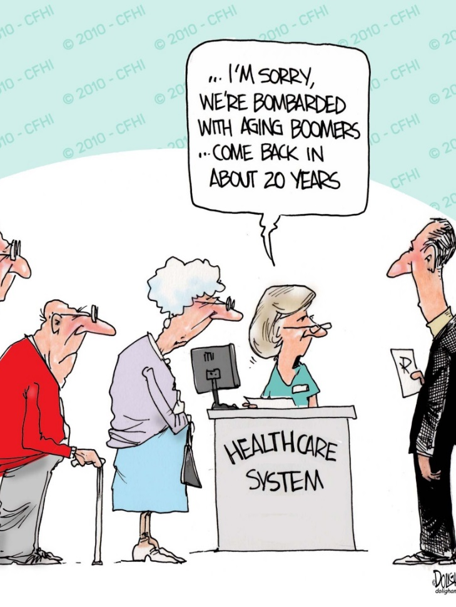
Ageing transition
The world is growing older
In many countries old people will form the majority
Massive implications for health and social care services, labour availability
Health status and health expenditure
Will be people be more or less healthy as they age?
McCracken and Phillips (2012)

Slide 48
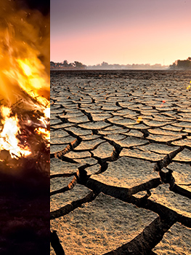
Factors influencing global health?
Global forces
Environmental changes – climate change , land degradation, loss of biodiversity, ocean acidification, desertification
Changes in human environment- globalisation, population increase, increased urbanisation
McCracken and Phillips (2012)

Slide 49

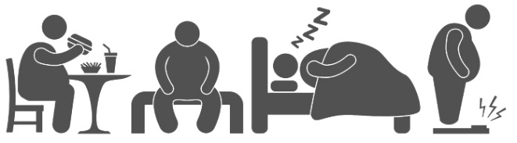
Increase in non communicable diseases
1950s-1970s chronic and degenerative conditions rapidly increasing in western developed nations
High smoking levels, high fat diets, diets rich in sugar, salt and fat and increasingly sedentary lifestyles
Cancer is now replacing heart disease as one of the leading degenerative causes of death in more recent times
McCracken and Phillips (2012)
Notes:
Rising death rates from cardiovascular diseases ( up until 1970s then improved advances in treatment of cardiovascular diseases) and stroke

Slide 50

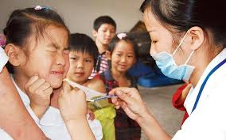
Scientific and technological advances
From 1960s onwards scientific and technological progress has improved population health making most major infectious diseases treatable /medically preventable
Infant and child survival have been greatly improved from the development of vaccines for polio, measles, mumps, rubella, chickenpox, meningitis, pneumonia .
McCracken and Phillips (2012)
Notes:
Introduction of oral rehydration therapy in 1970s, zinc supplement therapy ( since 2000) to fight diarrhoeal disease has saved millions of lives
Better nutrition, improved living standards , increased access to education and improvements in women’s rights have been essential components to improvements in medical advances

Slide 51
Bibliography
Baylis, J., Smith, S and Owens, P (2008) The globalisation of world politics. Oxford: Oxford University Press
Beagle, R and Bonita R (2010) ‘ What is global health?’ Global health action, 3: 5142
Donaldson C, Gerard K. 2004. Economics of Health Care Financing (2nd edition).Basingstoke: Palgrave (Chapters 4 and 5)
Gottret P, and Shieber G. 2006. Health Financing Revisited, A Practitioner’s Guide. The World Bank
Global Health Strategy 2014-2019. (2014) London : Public Health England
Hanfield, J (2015) Globalisation and Health (2nd ed) Maidenhead : McGraw Hill/ Open University
Held D , McGrew, A Goldblatt, D and Perraton, J (1999) Global Transformations, Politics, Economics and Culture. Stanford, CA: Stanford University Press.
HM Government ( 2011) Health is global : An outcomes framework for Global Health London: HMSO. available at
https://www.gov.uk/government/uploads/system/uploads/attachment_data/file/67578/health-is-global.pdf
Jacobsen, K ( 2014) Introduction to Global Health (2nd ed) Jones and Bartlett Learning, Burlington , MA, USA.
Keen J, Light D, Mays A. 2001. Public-Private Relations in Health Care. King’s Fund
Maynard A (ed). 2005. The Public-Private Mix for Health. The Nuffield Trust
McCracken, K., and Phillips D.R., (2012) Global Health : An Introduction to current and future trends
Oxon: Routledge
Skolnik, R ( 2016) Global health 101 ( 3rd Ed) . Jones and Bartlett Learning , Burlington, MA, USA
WHO (2009) Global Health Risks. Available at
http://www.who.int/healthinfo/global_burden_disease/GlobalHealthRisks_report_full.pdf?ua=1&ua=1
WHO – World Health Statistics (2016) available at
http://www.who.int/gho/publications/world_health_statistics/2016/en/
Notes:
OECD 2004, Health Data, 3rd Edition. Paris
The World Bank. 2006. Health Financing Revisited, A Practitioner’s Guide.

